Slide 1
JSON with T-SQL

Slide 2
JSON
JavaScript Object Notation, a popular data-interchange format
Easy for human to read and write and easy for machines to parse and generate
can be deserialized to or serialized from a python dictionary easily
JSON is supported in SQL Server 2016+, you can:
Parse JSON text and read or modify values.
Transform arrays of JSON objects into table format.
Run any Transact-SQL query on the converted JSON objects.
Format the results of Transact-SQL queries in JSON format

Slide 3
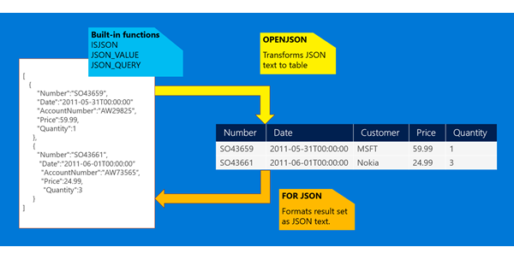
JSON

Slide 4
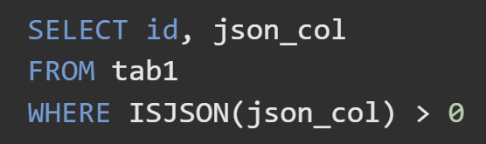
JSON
built-in functions in T-SQL
ISJSON( expression )
tests whether a string contains valid JSON.
returns 1 if the string contains valid JSON; otherwise, returns 0. Returns null if expression is null.

Slide 5
JSON
built-in functions in T-SQL
JSON_VALUE( expression, path)
extracts a scalar value from a JSON string.
Returns a single text value of type nvarchar(4000)
use OPENJSON if value will be longer than 4000 chars
JSON_QUERY( expression, path)
extracts an object or an array from a JSON string.

Slide 6
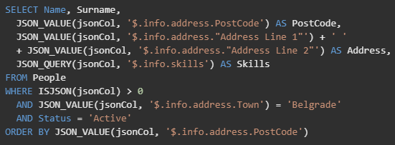
JSON

Slide 7
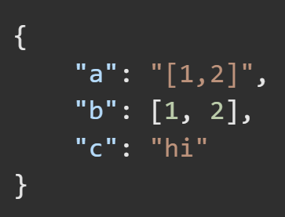
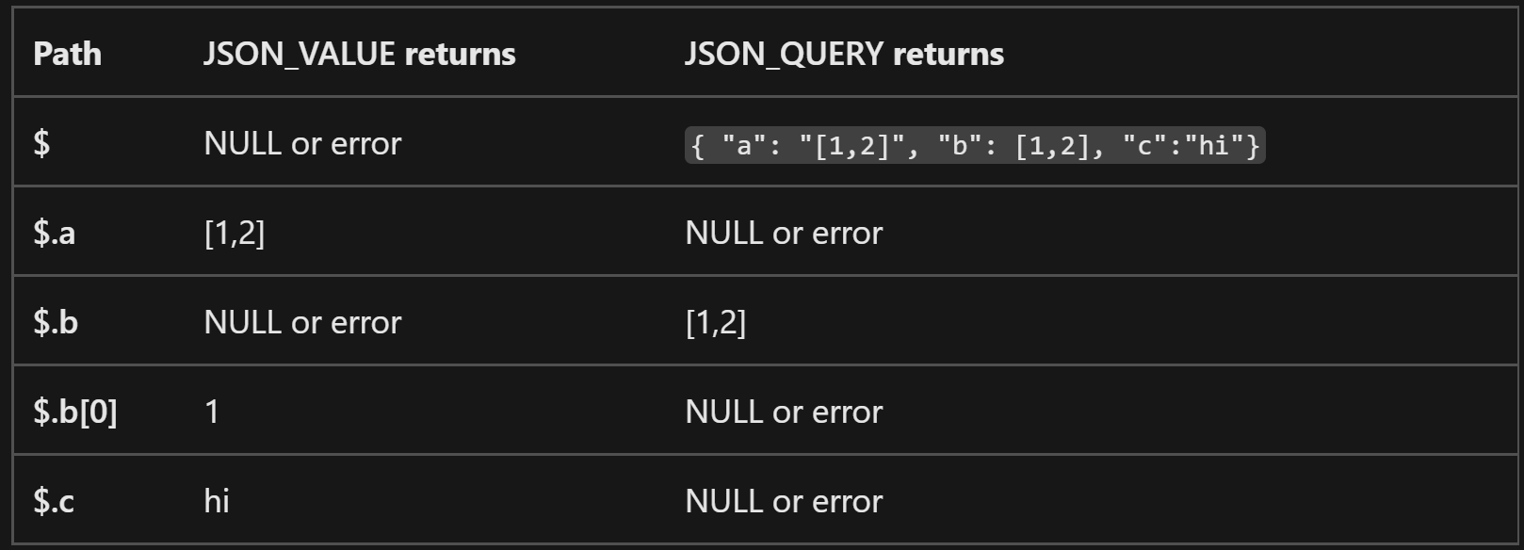
JSON
JSON_VALUE vs JSON_QUERY

Slide 8
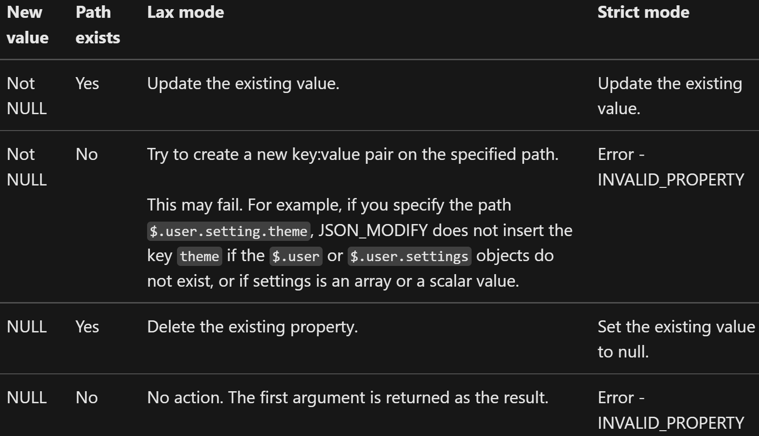
JSON
built-in functions in T-SQL
JSON_MODIFY( expression , [append] [ lax | strict ] $.<json path> , newValue )
changes a value in a JSON string.
append: append to <json path>.
lax: the property referenced by <json path> does not have to exist, the default mode.
strict: the property referenced by <json path> must be in the JSON expression, else you get an error

Slide 9
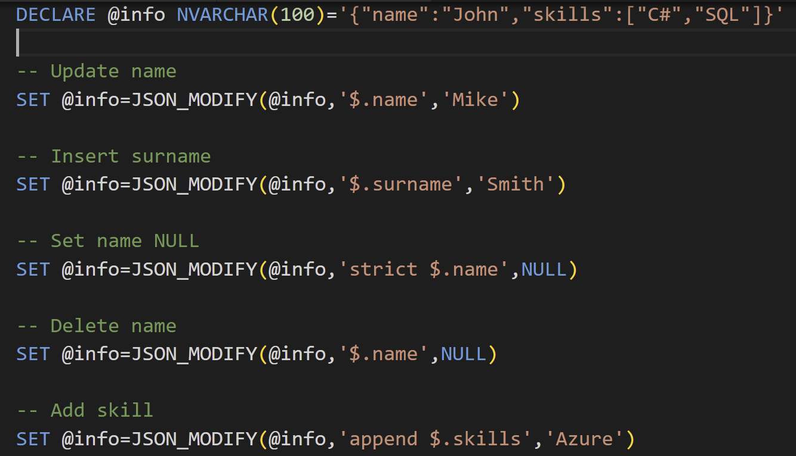
JSON

Slide 10
JSON
OPENJSON
The OPENJSON rowset function converts JSON text into a set of rows and columns
From a JSON object, the function returns all the key/value pairs that it finds at the first level.
From a JSON array, the function returns all the elements of the array with their indexes.
You can add an optional WITH clause to provide a schema that explicitly defines the structure of the output

Slide 11
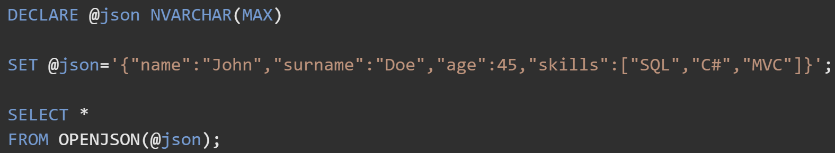
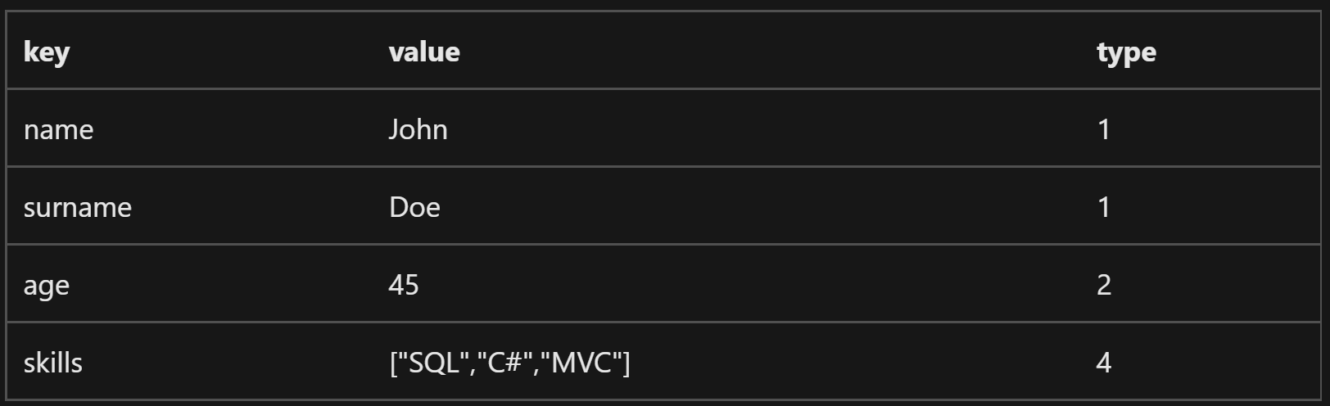
JSON
Without an explicit schema, OPENJSON will return three columns

Slide 12
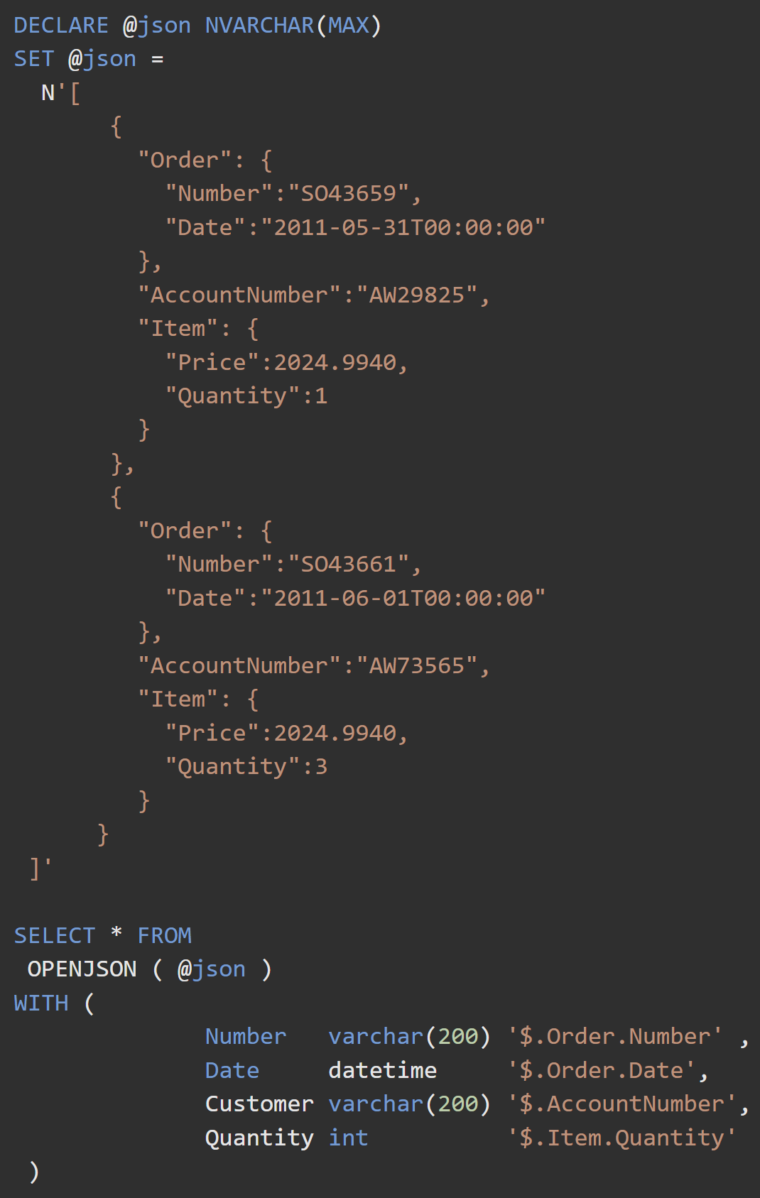
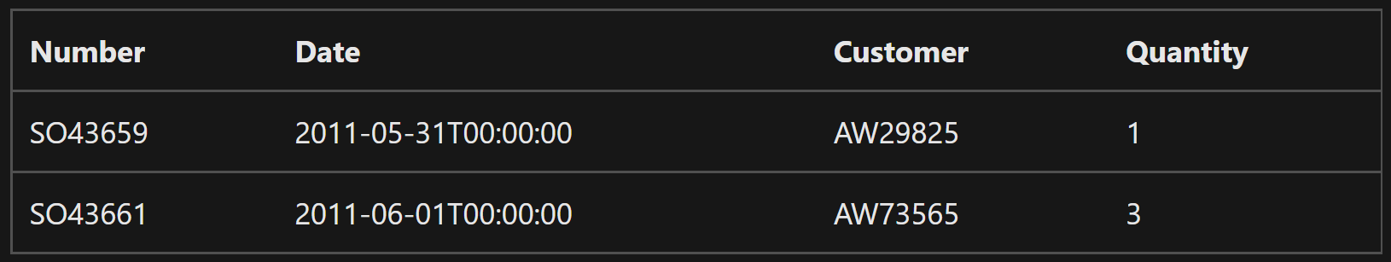
JSON
You can customize the behavior of OPENJSON with an explicit schema

Slide 13
JSON
There is also FOR JSON, which can convert sql data types to JSON
It’s quite complex, and there are many others ways to create JSON from relational tables.
https://docs.microsoft.com/en-us/sql/relational-databases/json/how-for-json-converts-sql-server-data-types-to-json-data-types-sql-server?view=sql-server-ver15

Slide 14
DML & Related

Slide 15
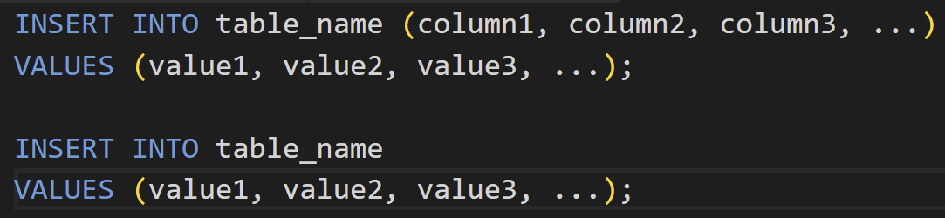
INSERT INTO
Two ways to use INSERT INTO
specify both column names and values -> only provide values for specified columns
specify only the values -> there must be a value present for every column

Slide 16
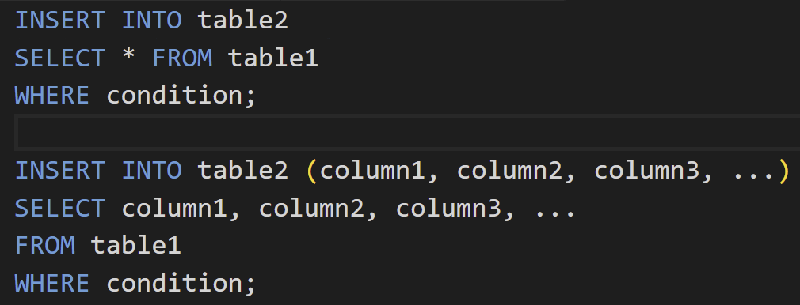
INSERT INTO SELECT
Copies data from one table to another
Table schema for the source and target tables must match

Slide 17
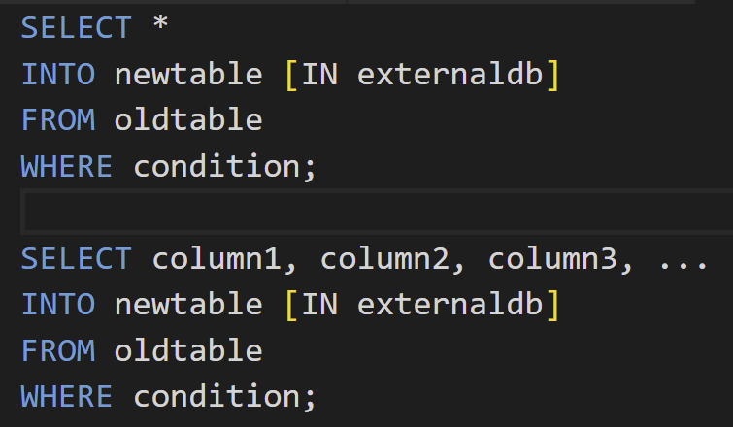
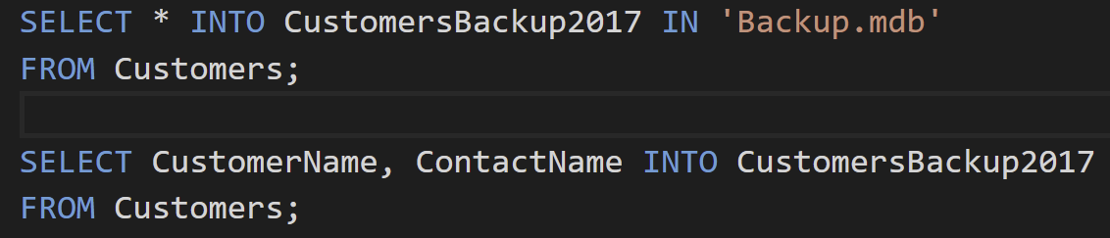
SELECT INTO
Copies data from one table to another

Slide 18
SELECT INTO vs INSERT INTO
Select into doesn’t require the target table to exist, while insert into does
select into is typically used with intermediate data sets like #temp_tables, Insert into is typically used for existing tables when the target table structure is well know.

Slide 19

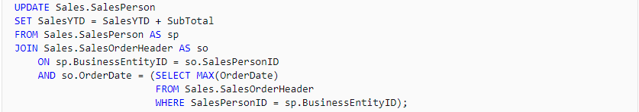
Update
Without WHERE, all records will be updated

Slide 20

Delete
Delete works row by row
without out a where condition, all records in the table will be deleted

Slide 21
Truncate
Removes all rows from a table or specified partitions of a table, without logging individual row deletions.
Similar to a DELETE without a WHERE, but faster, uses fewer system and transaction log resources

Slide 22
Delete vs Truncate vs Drop
 | DELETE | TRUNCATE | DROP
Type | DML | DDL | DDL
Uses a lock | Row lock | Table lock | Table lock
Works in WHERE | Yes | No | No
Removes ... | One, some, or all rows in a table. | All rows in a table. | Entire table structure: data, privileges, indexes, constraints, triggers.
Resets ID auto-increment/identity | No | Yes | Doesn’t apply
Rollback | Yes | Yes | Yes
Transaction logging | Each row | Whole table (minimal) | Whole table (minimal)
Works with indexed views | Yes | No | No
Fires DELETE triggers | Yes | No | No
Speed | Slow | Fastest | Faster

Slide 23
Merge
Runs DML(insert, update or delete) on a target table from the result of a join with a source table.
Performance can be highly dependent on having the correct indexes and performing any joins efficiently, so don’t use unless two tables have a complex mixture of matching characteristics.
If used correctly, will be able to reduce I/O, as you are combining multiple operations into one.

Slide 24
Merge
You can specify NOT MATCHED behavior based on a mismatch in source or target
NOT MATCHED BY source: a record is present in target, but not in source, often leads to a DELETE, or simply ignored
NOT MATCHED BY target: a record is present in source, but not in target, often leads to an INSERT.
Example in next slide

Slide 25
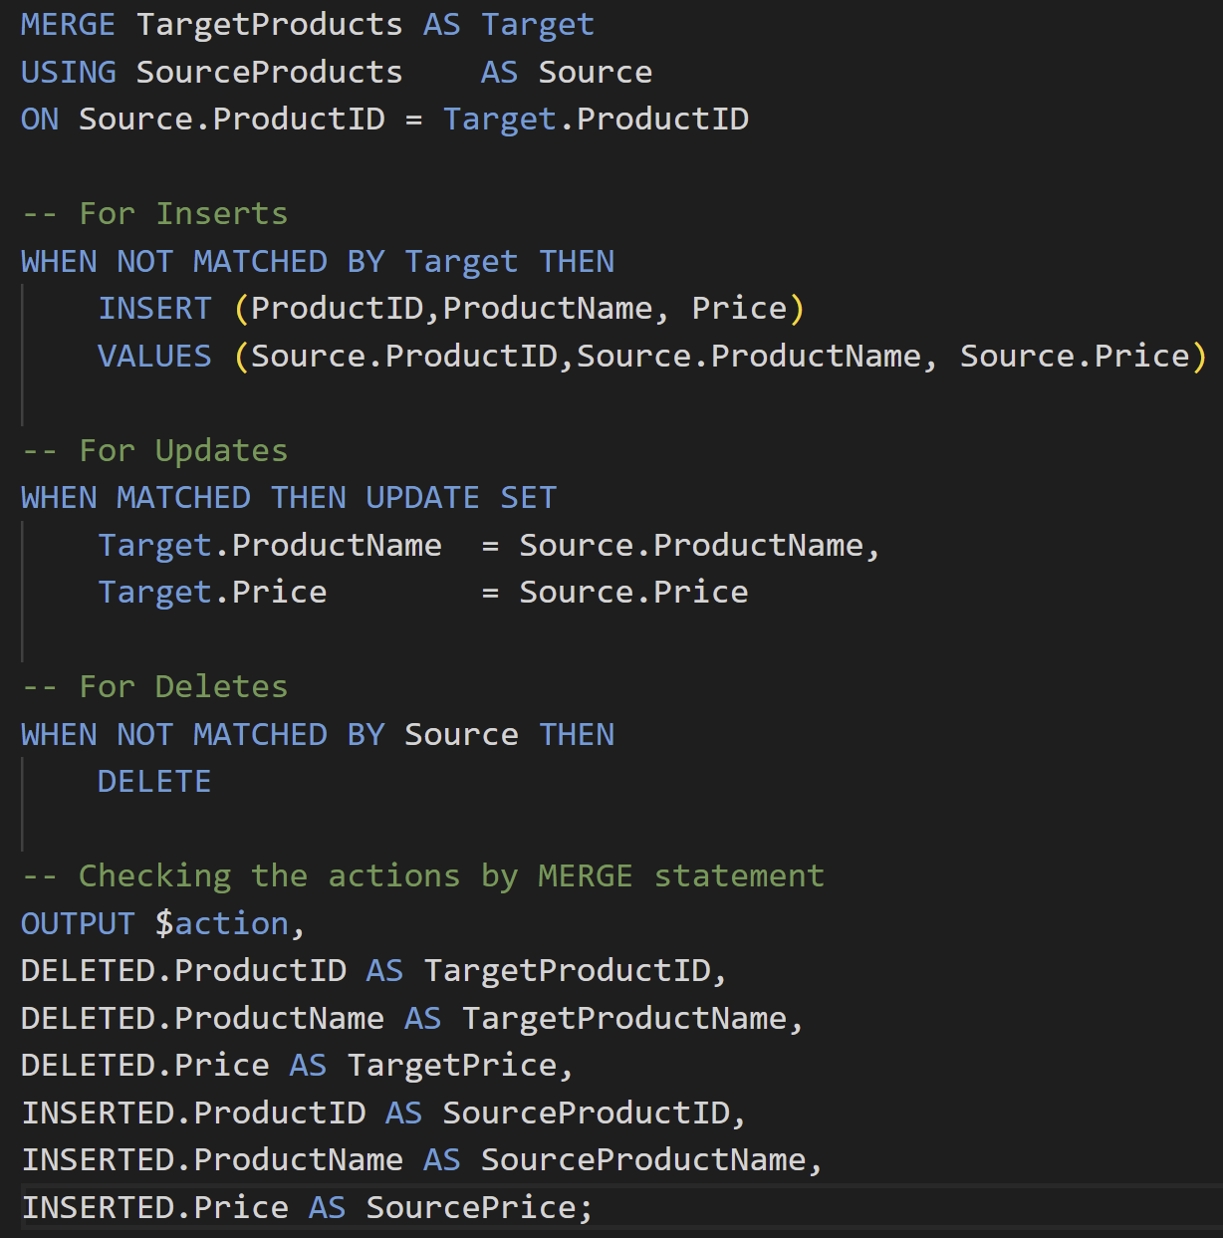
Merge

Slide 26
Output
Used in Delete, Insert, Update and Merge, returns each row affected by those commands.
Often used for CDC(Change Data Capture) or auditing
Gives access to two virtual tables (Magic Tables):
“INSERTED” contains the new rows (INSERT or UPDATE‘s SET)
“DELETED” contains the old copy of the rows(empty for INSERT)
You can also use OUTPUT INTO to insert into a table variable
OUTPUT has access to all the columns in the related table, not just the ones mentioned in the query

Slide 27
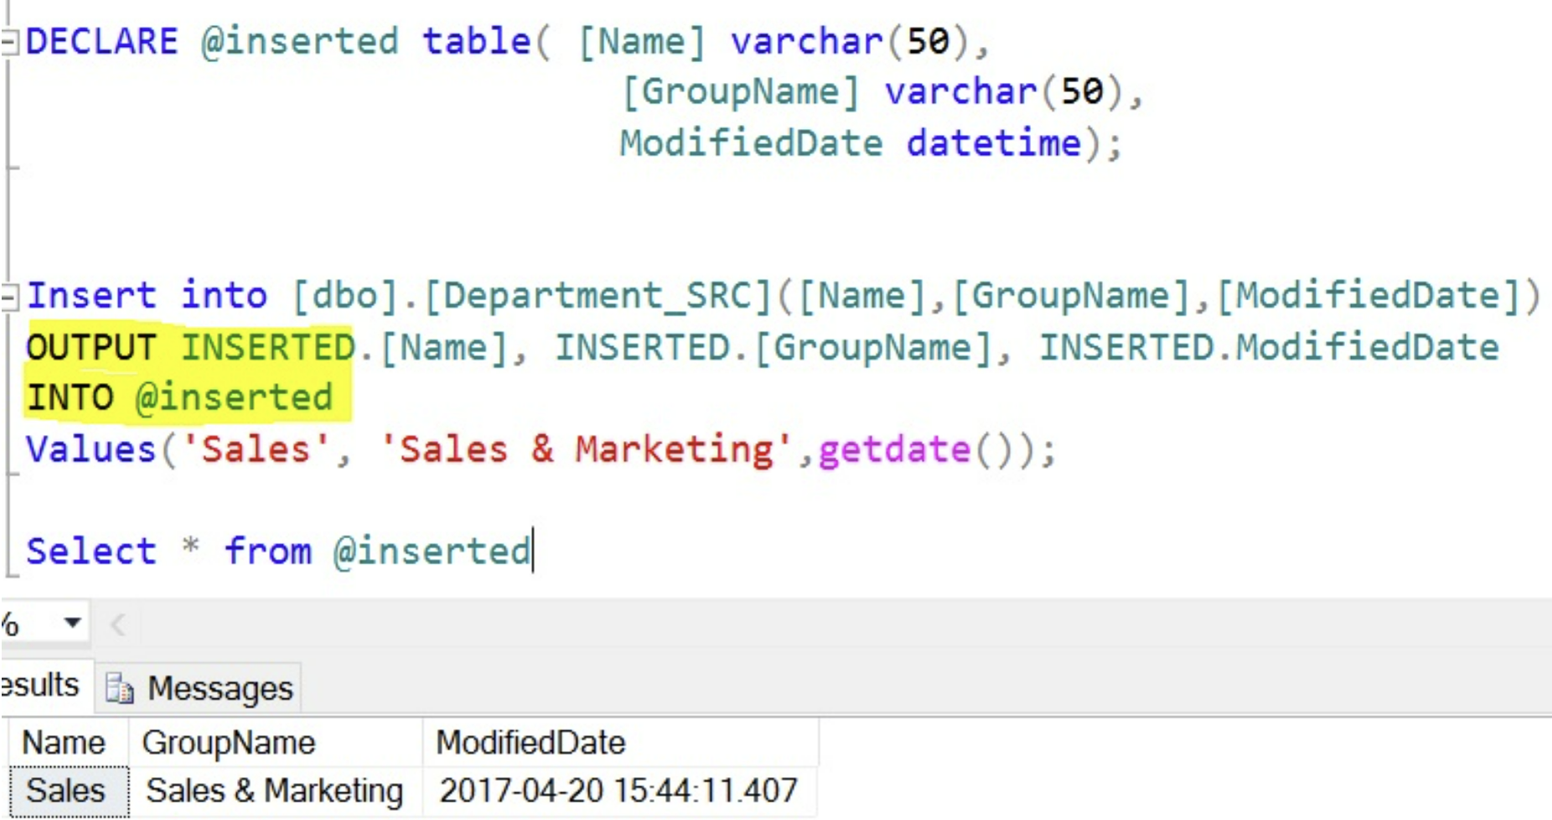
Output
Insert into a table variable

Slide 28
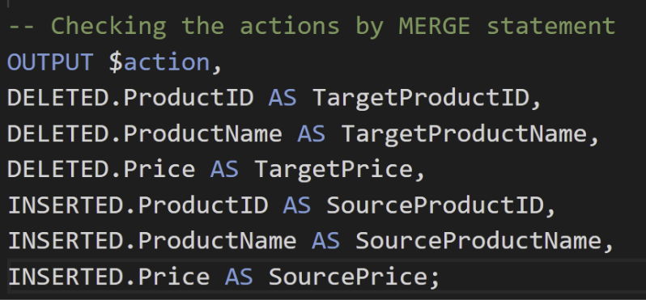
Output
For MERGE specifically, we can use $action to retrieve whatever action was taken on a particular row(INSERT, UPDATE, DELETE)

